Slide 1
Intro to Teaching Strategies GOLD
October 2022
Ms. Alyssa Tortora

Slide 2
What is Teaching Strategies GOLD
https://www.youtube.com/watch?v=df8gcopKQyo

Slide 3
What is Teaching Strategies GOLD?
What do you remember?

Slide 4
What is Teaching Strategies GOLD
◦ Teaching Strategies Gold (TSG) is an ongoing assessment model covering all developmental and academic skill areas
◦ It’s a tool to document children’s learning over time, inform instruction, and facilitate communication with families
◦ These areas include the following: ◦ Social emotional developmental ◦ Physical development ◦ Language development ◦ Cognitive skills ◦ Literacy skills ◦ Math skills ◦ Science and Technology skills ◦ Social studies skills ◦ Art development

Slide 7
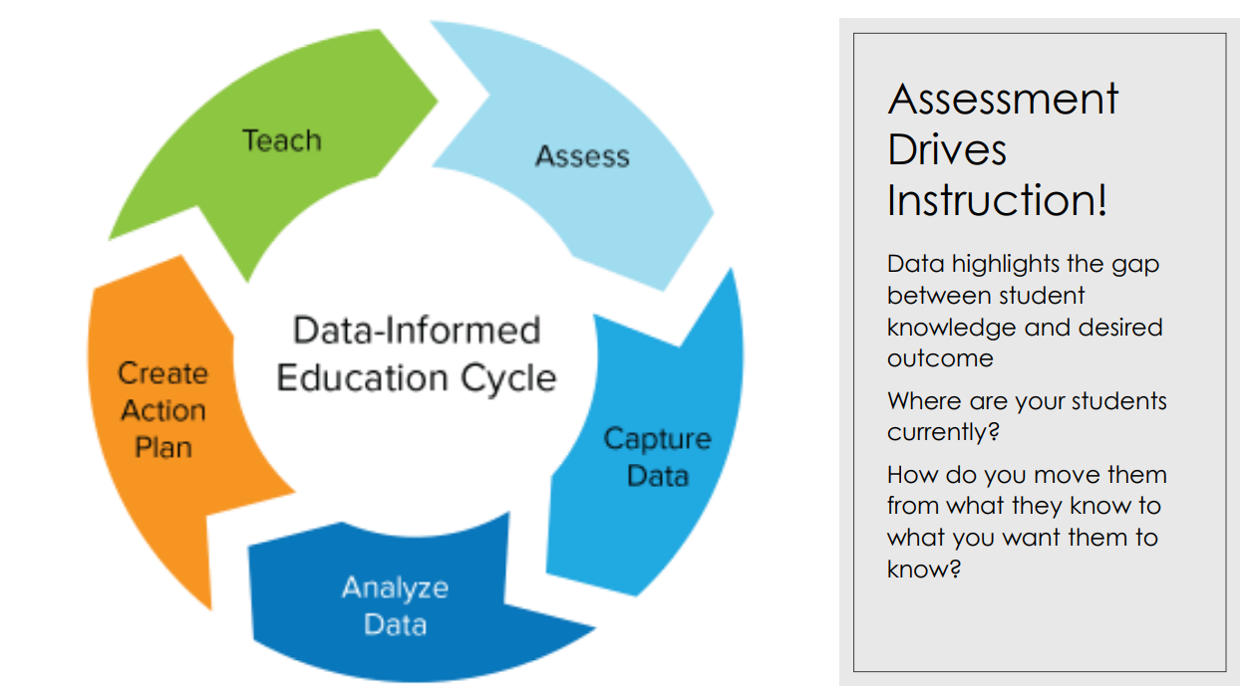

Slide 9
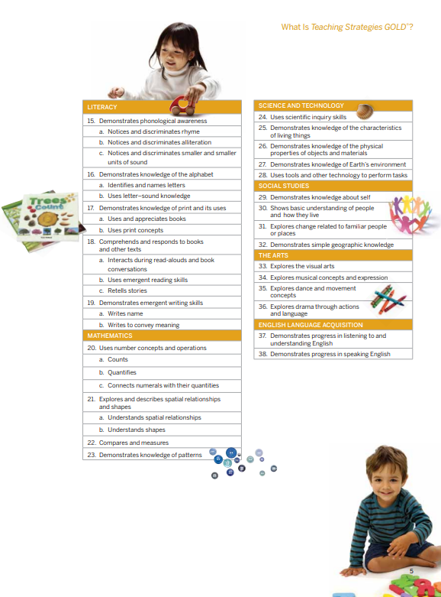

Slide 10
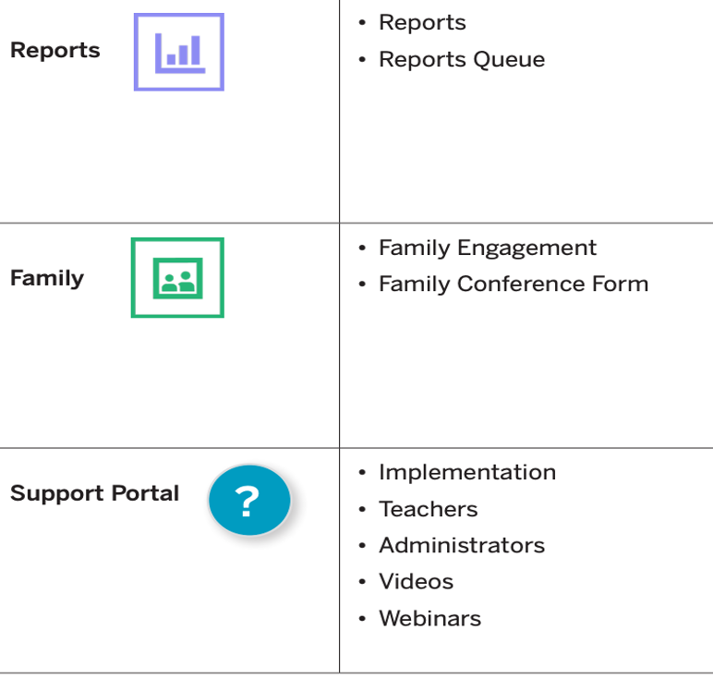

Slide 11
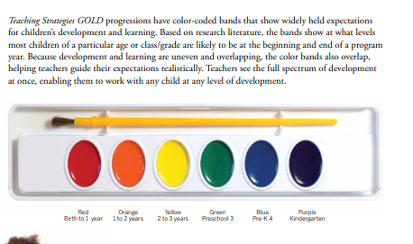

Slide 12
You should have already!
Logged into your Teaching Strategies GOLD Account.
(write down your password)
Checked your roster.
If you have any students that need to be added or removed email Ms. Tortora names.

Slide 13
Add Documentation
Child went to his cubby and grabbed his stuffed animal when he was upset.

Slide 14
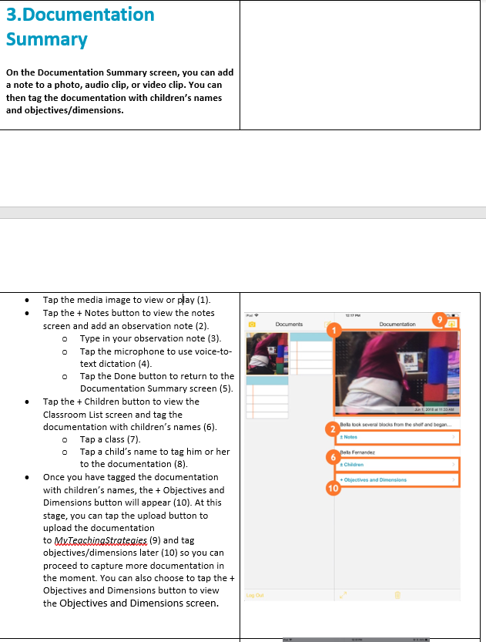
Child went to his cubby and grabbed his stuffed animal when he was upset.
Children:Demo student
Objectives and dimensions: regulates emotions and behaviors

Slide 15
Objectives: Manages feelings

Slide 16
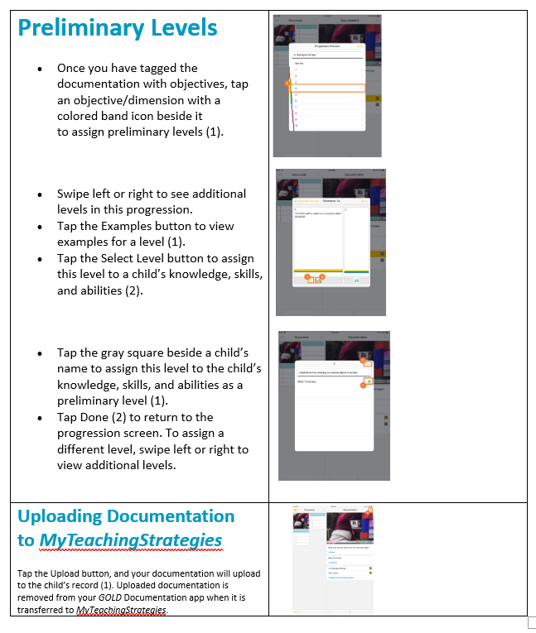
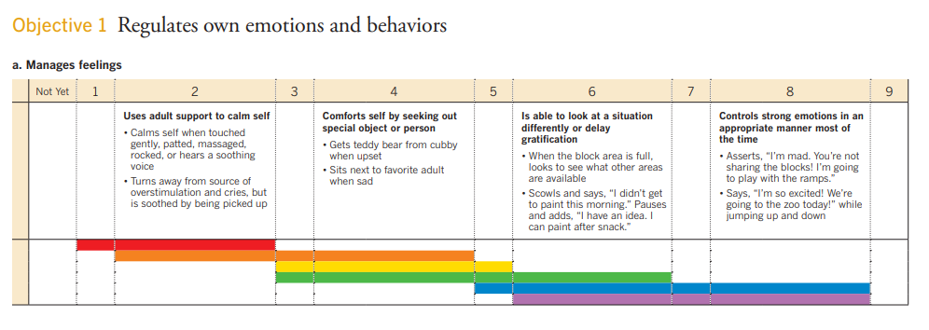

Slide 17
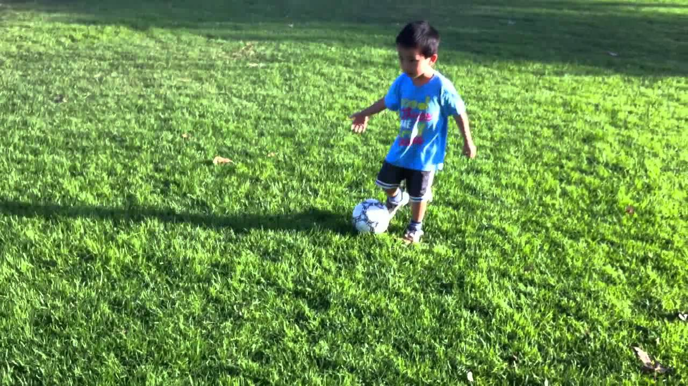

Slide 18
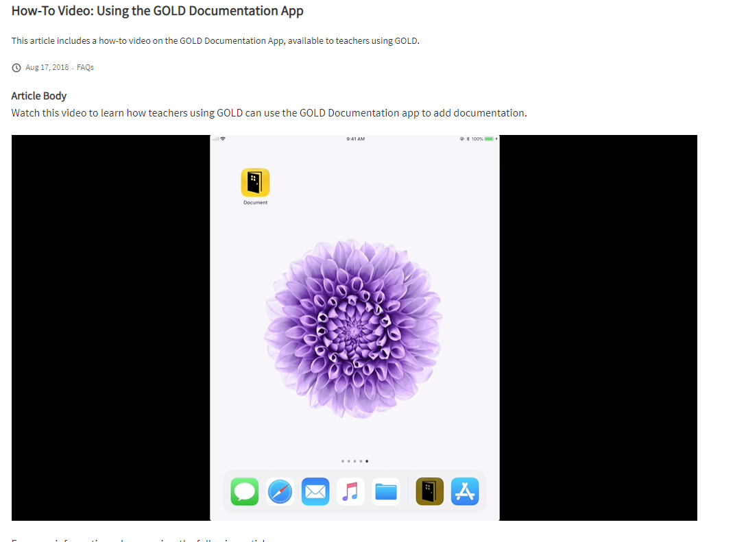
https://teachingstrategies.force.com/portal/s/article/Video-GOLD-Documentation-App-for-Teachers
Directions
https://teachingstrategies.force.com/portal/s/article/How-do-I-add-documentation-with-the-GOLD-Documentation-app-with-an-iOS-device

Slide 19
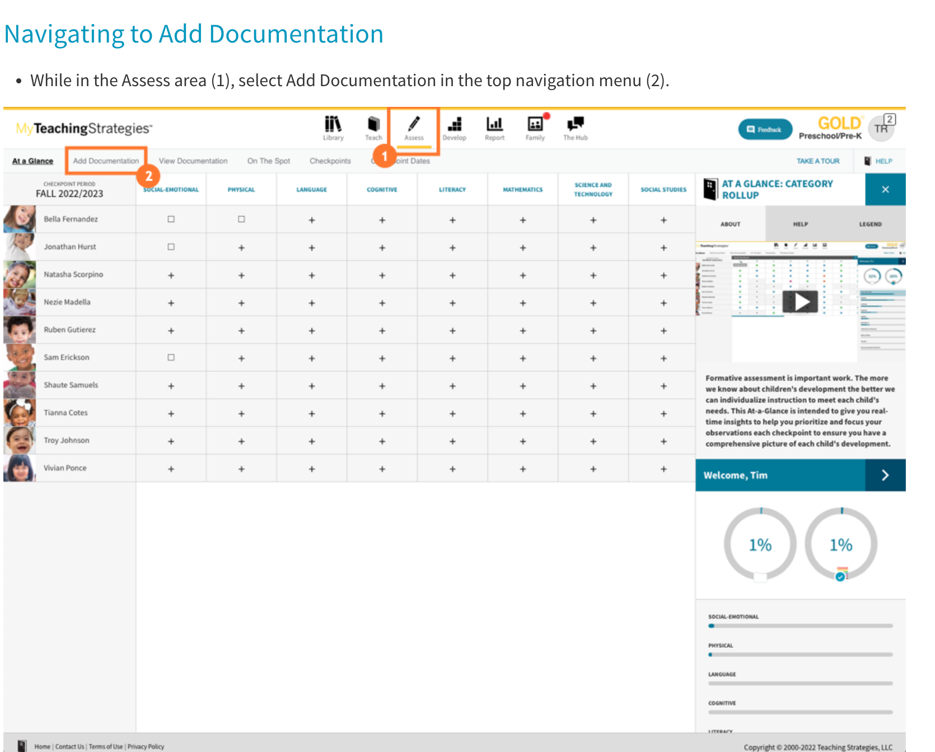
Add Documentation
Click on the Assess tab.
While in the assess area select Add documentation in the top navigation menu.
You will see the add documentation screen. As you begin to enter the documentation you can save at any point.

Slide 20
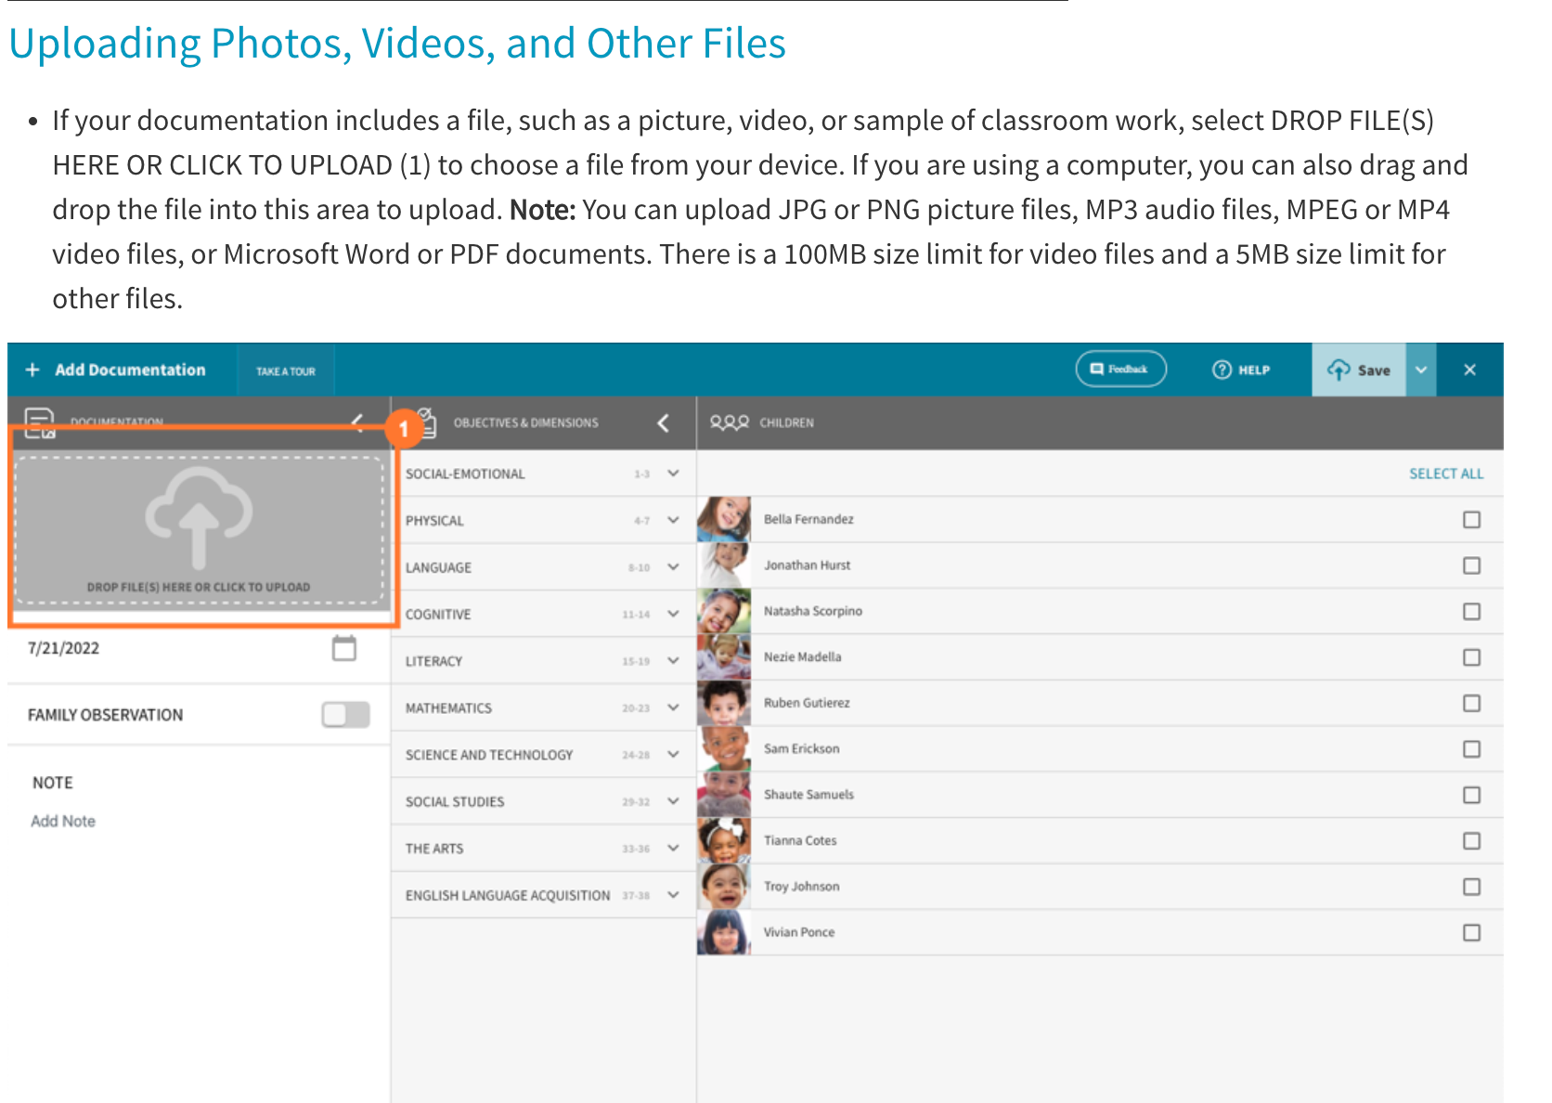
If your documentation includes a file, such as a picture, video, or sample of classroom work, select DROP FILE(S) HERE OR CLICK TO UPLOAD (1) to choose a file from your device. If you are using a computer, you can also drag and drop the file into this area to upload.
Once the file has uploaded, a thumbnail image will appear in the upload file area.
Select the icon on the top left corner to upload more files (1).
Select the thumbnail image to view the file (2). You will find the option to delete the file when viewing the full file.
If you have uploaded multiple files, you can toggle between them (3).

Slide 21
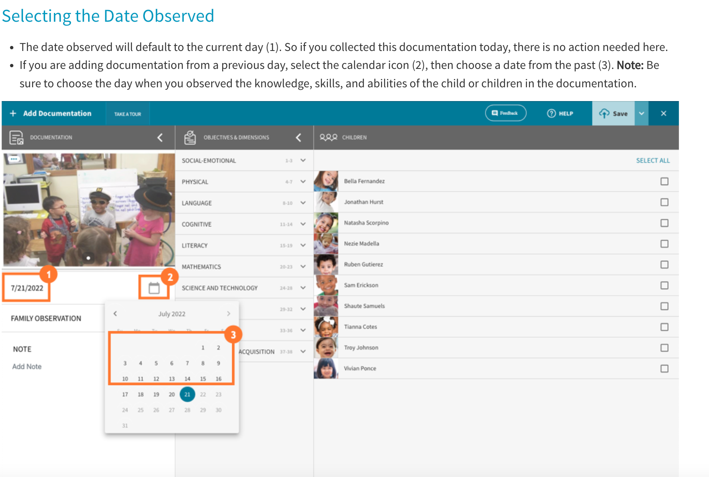
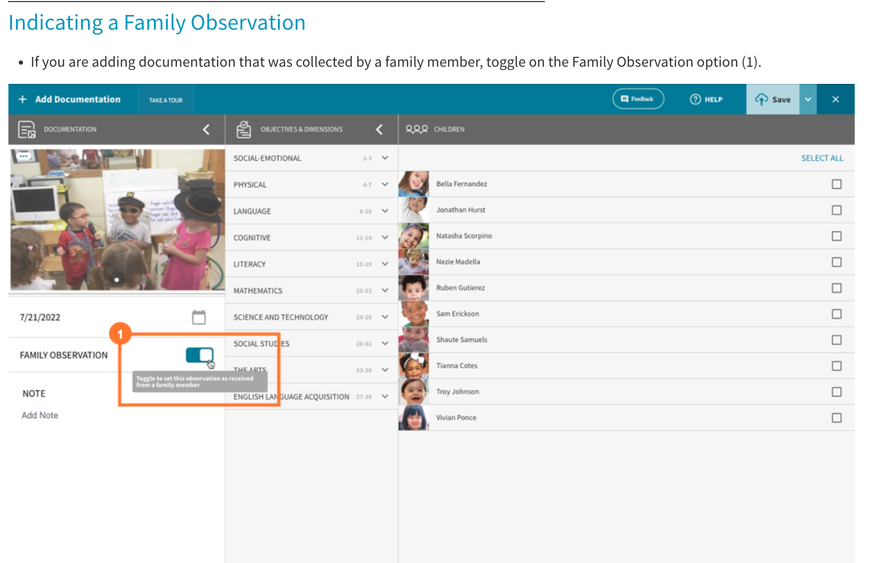
Selecting the Date Observed
The date observed will default to the current day (1). So if you collected this documentation today, there is no action needed here.
If you are adding documentation from a previous day, select the calendar icon (2), then choose a date from the past (3). Note: Be sure to choose the day when you observed the knowledge, skills, and abilities of the child or children in the documentation.
Indicating a Family Observation
If you are adding documentation that was collected by a family member, toggle on the Family Observation option (1).

Slide 22
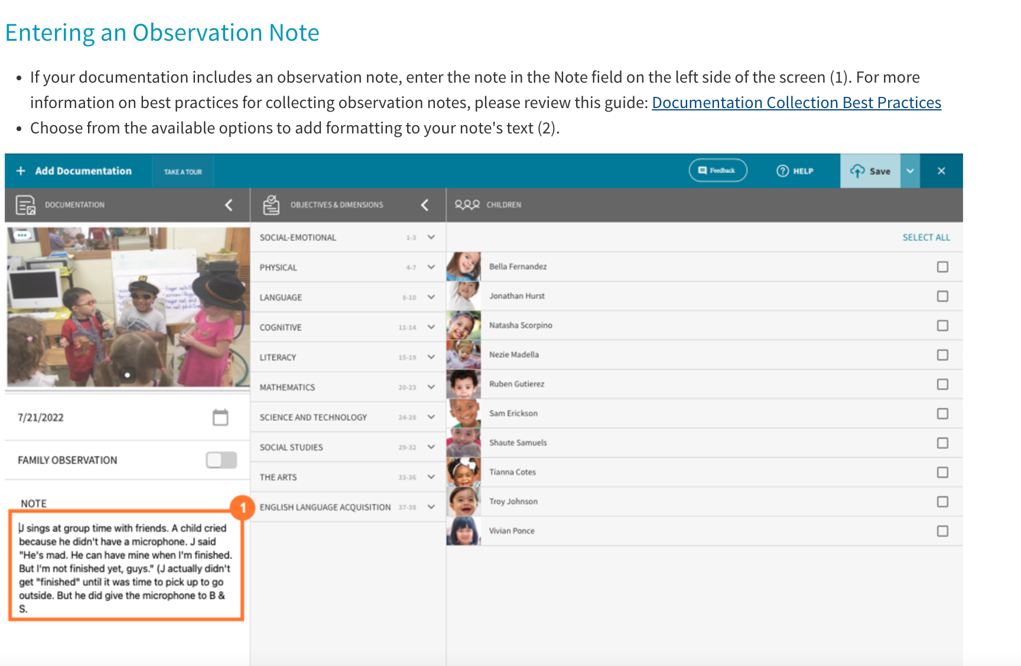

Slide 23
Tagging Children
If you have already tagged an objective or dimension to the documentation:Select Add Children (1) in the Children panel.
Your class list (or caseload if you are a team member) will appear in a modal (1). Select all children captured in the documentation to tag them.
If all of the children are in the documentation, choose SELECT ALL to tag all children (2).
Select Update (3).

Slide 24
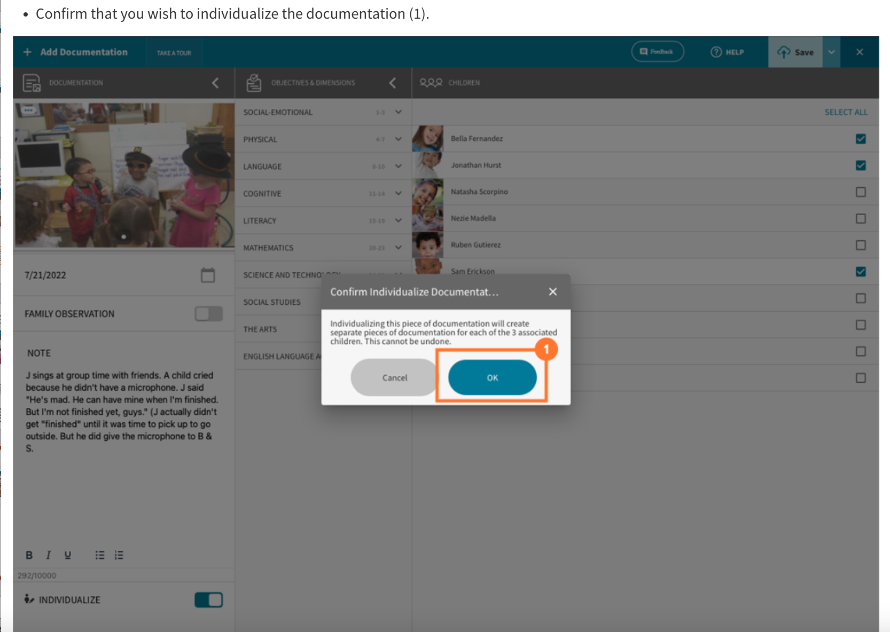
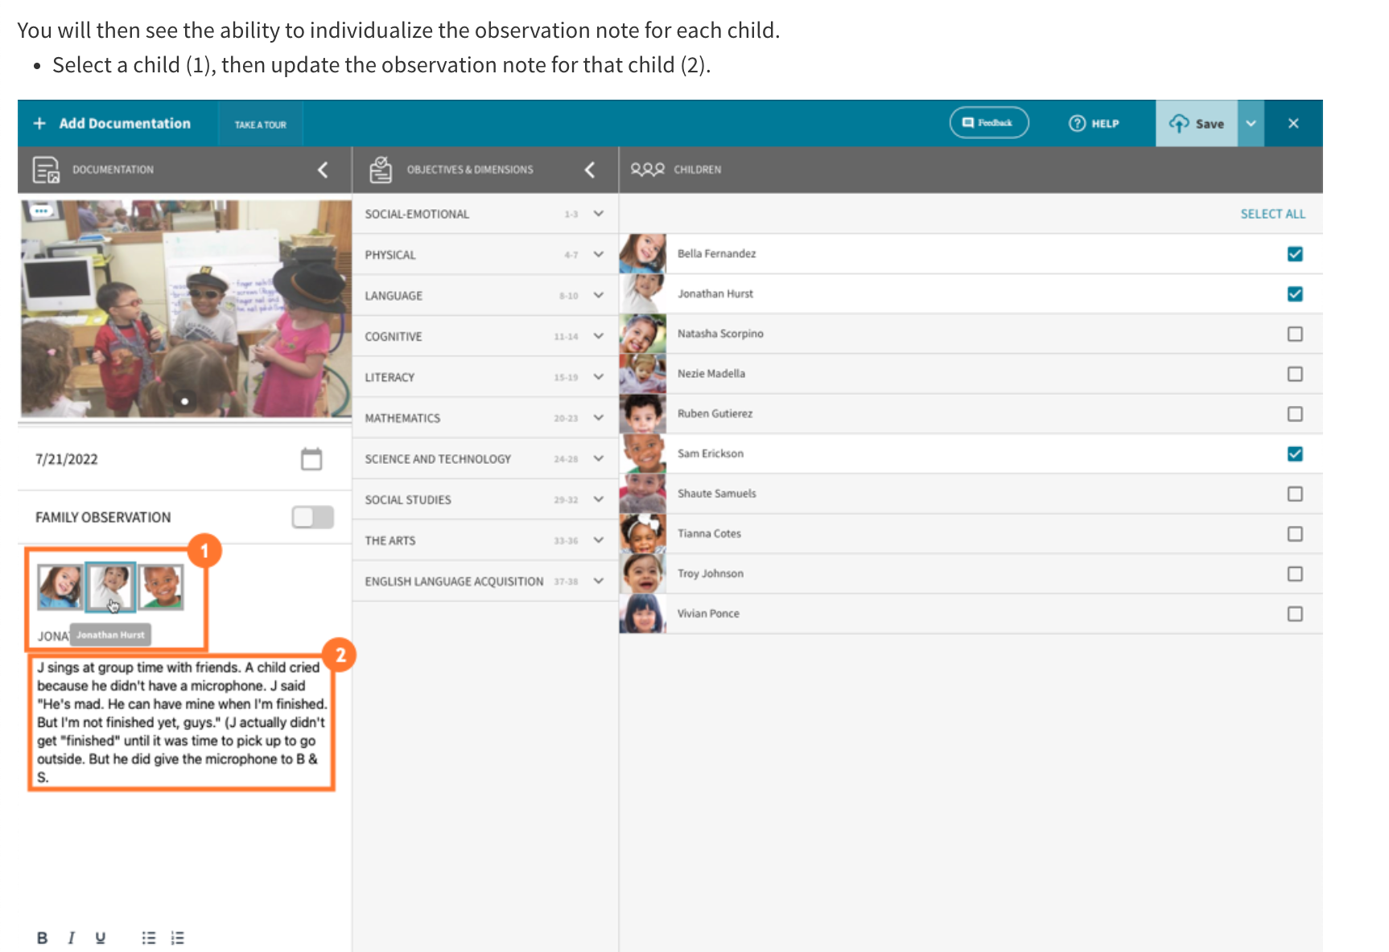
Individualizing Documentation
Individualizing Documentation
If you have multiple children tagged to the documentation, and some children demonstrate different skills than the others, you can use the individualize feature to create separate pieces of documentation for each of the tagged children. Select the Individualize toggle (1).
Confirm that you wish to individualize the documentation (1).
You will then see the ability to individualize the observation note for each child.Select a child (1), then update the observation note for that child (2).

Slide 25
View Documentation
View Documentation
To view the documentation:
Select view documentation
-select which student/objective (filter)

Slide 26
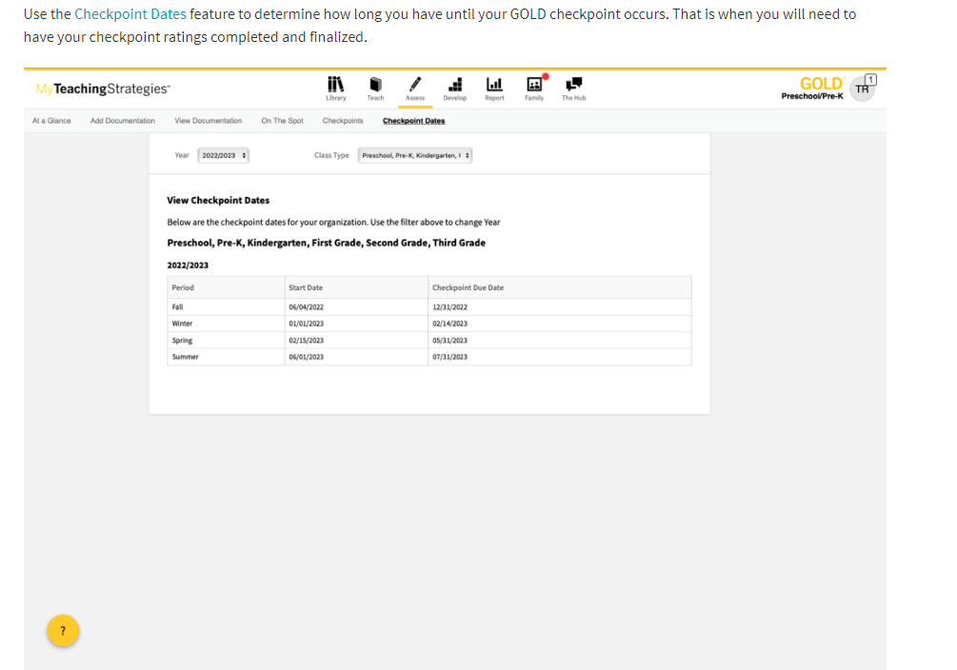
View Checkpoints

Slide 27
Resources
Golds How to Videos
https://teachingstrategies.force.com/portal/s/article/Video-GOLD-Documentation-App-for-Teachers
Golds How to Manual for Teachers
https://teachingstrategies.com/wp-content/uploads/2021/08/MyTeachingStrategies-Guide-for-Teachers.pdf
https://teachingstrategies.force.com/portal/s/gold-product-documentation
Golds Video Portal

